Slide 1
4.48 Psychosis – my pitch
Abigail Styler

Slide 2
4.48 psychosis initial research
4.48 Psychosis was a play written by Sarah Kane in the time period just before she committed suicide.
4.48 possibility of Suicide note. Her family thought that it wasn’t but the public did but no one ever found out the truth.
4.48 could be a bibliographical time and is apparently known to be the time that people take their own lives.
Doesn’t mention gender, state how many people there are (ages), stage directions (‘Silence’), setting or time frame.
Punctuation is untraditional (full stop could be seen to represent a heartbeat or a hospital monitor.
Poetic (some scenes use onomatopoeia – which is words like bang, smash, crash)
Parts are like a stream of consciousness
Scenes that are just random numbers
There are different interpretations (play could be a whole psychotic episode)
Suggests that she is having an affair with her doctor during one of the scenes
Multitude of voices, no idea of how Sarah Kane wanted it to be staged
Uses a lot of metaphors in nearly every scene
It was written in a non linear way.
Uses a lot of pronouns within the play so this doesn’t suggest gender for the ‘characters’.
Doesn’t use traditional theatre form
There are a lot of references to the bible and this is from John and Matthew but also from other places within the bible too. This was used to show that she despised religion throughout her life.

Slide 3
SARAH KANE Initial research
Critics wrote a letter years after she died to apologise for their words and called her the ‘playwright of the generation’.
She studied classical people such as Shakespeare. She went to the University of Birmingham and studied playwrighting.
In her plays she didn’t focus on characters, she wanted to focus on feelings and the bigger picture.
Her family were religious but she was very against religion. (A lot of references to the bible). She believed that she was a born again Christian in her late teens but then grew to despise it.
She struggled with her sexuality and no one knew whether this was because of her illness or not. This is why it was thought to be seen that she never mentioned anyone’s gender throughout the play.
Some people thought that she wrote this play because it was autobiographical but this was never proven.
Sarah Kane was born in 1971 but died in 1999 and she was 28 when she died.
She died by committing suicide by taking her shoe laces and tying them to a hospital toilet door and hanging herself.
Tried another time before in the hospital. She tried to commit suicide by taking 150 anti-depressants.
Sarah Kane was seen to be the face of ‘In-Ya-Face Theatre’ and this was violent theatre with an attack of modern society. This was a whole metaphysical issue. (I have watched two videos on YouTube that talk about this genre of theatre).
She wrote 6 plays and 4.48 Psychosis was her last one. Others included Crave and Cleanse
She wrote a play called cleanse and she talked about relating university dorms to concentration camps.
Critics didn’t like her works and criticised her publicly. They were seen to affect her illness in a negative way.
‘In-Yer-Face’ Theatre was a term used to describe a confrontational style of drama emerging in the 1990’s. It is seen to be the type of theatre that grabs the audience by the scruff of the neck and shakes it until it gets the message.

Slide 4
My main Idea – for a group routine
My main pitch idea is for a group routine based of the scenes that just use numbers.
Scene 4 is the scene where numbers are randomly placed and this provides a very chaotic atmosphere.
There would be everyone involved which would be 9 dancers and I would like to choreograph this routine and not be in the routine.
The main themes for this group routine would be Chaos and Sanity during a Psychotic episode.
There are 15 numbers in total and everyone would have a number. (Some people would have two).
I would like the audience to feel the chaos of the dancers and how they are feeling doing this routine and also how someone is feeling during an episode.
I would like to represent the feeling of being told to calm down during a psychotic episode and also the feeling at the start of an episode and the end when you start to feel more sane and sanity hits.
This will be represented by putting the dancers into different smaller groups and using skills such as accumulation and counterpoint to suggest a chaotic atmosphere and feeling.
Also this will be represented by using a variety of formations and a few solos and duets during the group number.
- The use of voices would be used at the beginning with the idea of the dancers speaking their numbers to highlight the theme and idea of this routine.

Slide 5
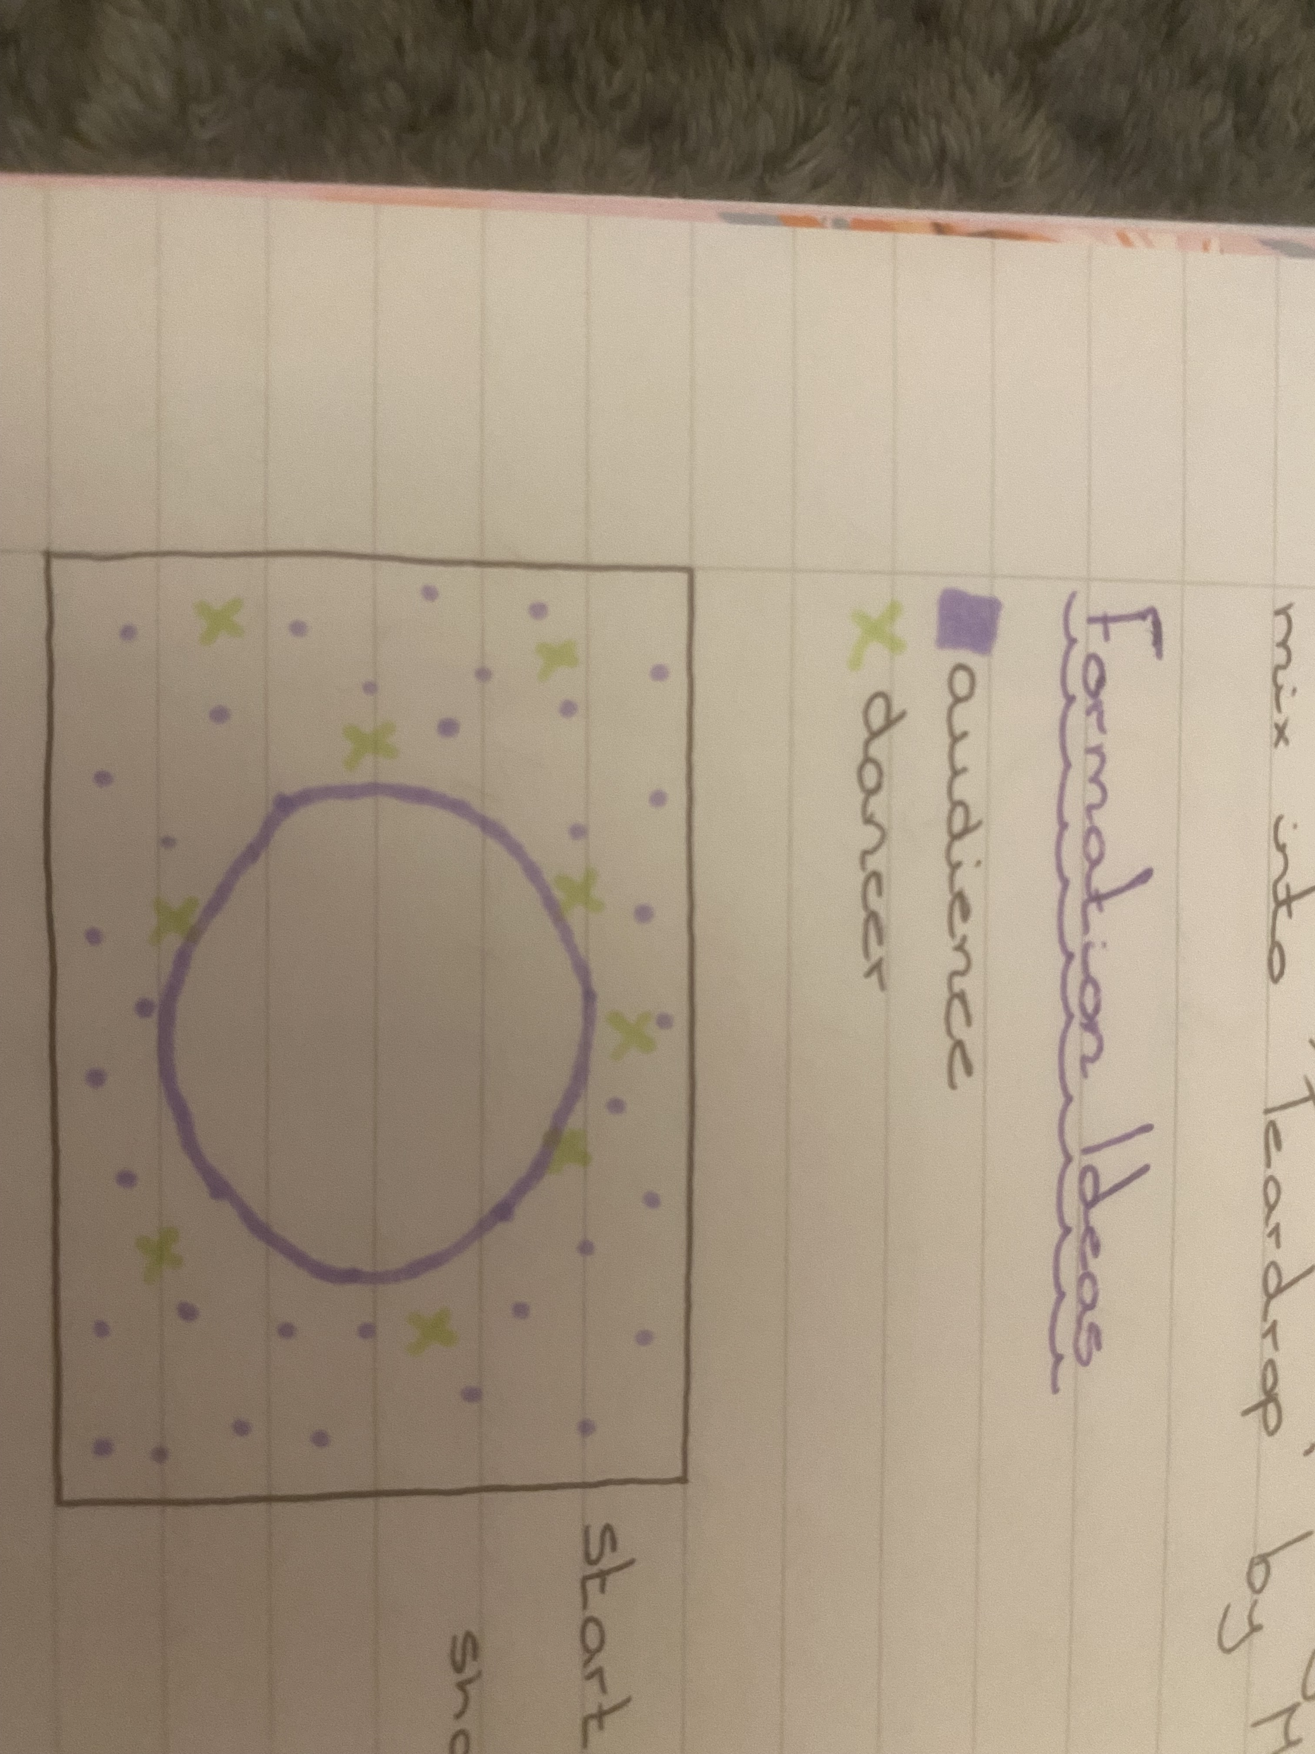
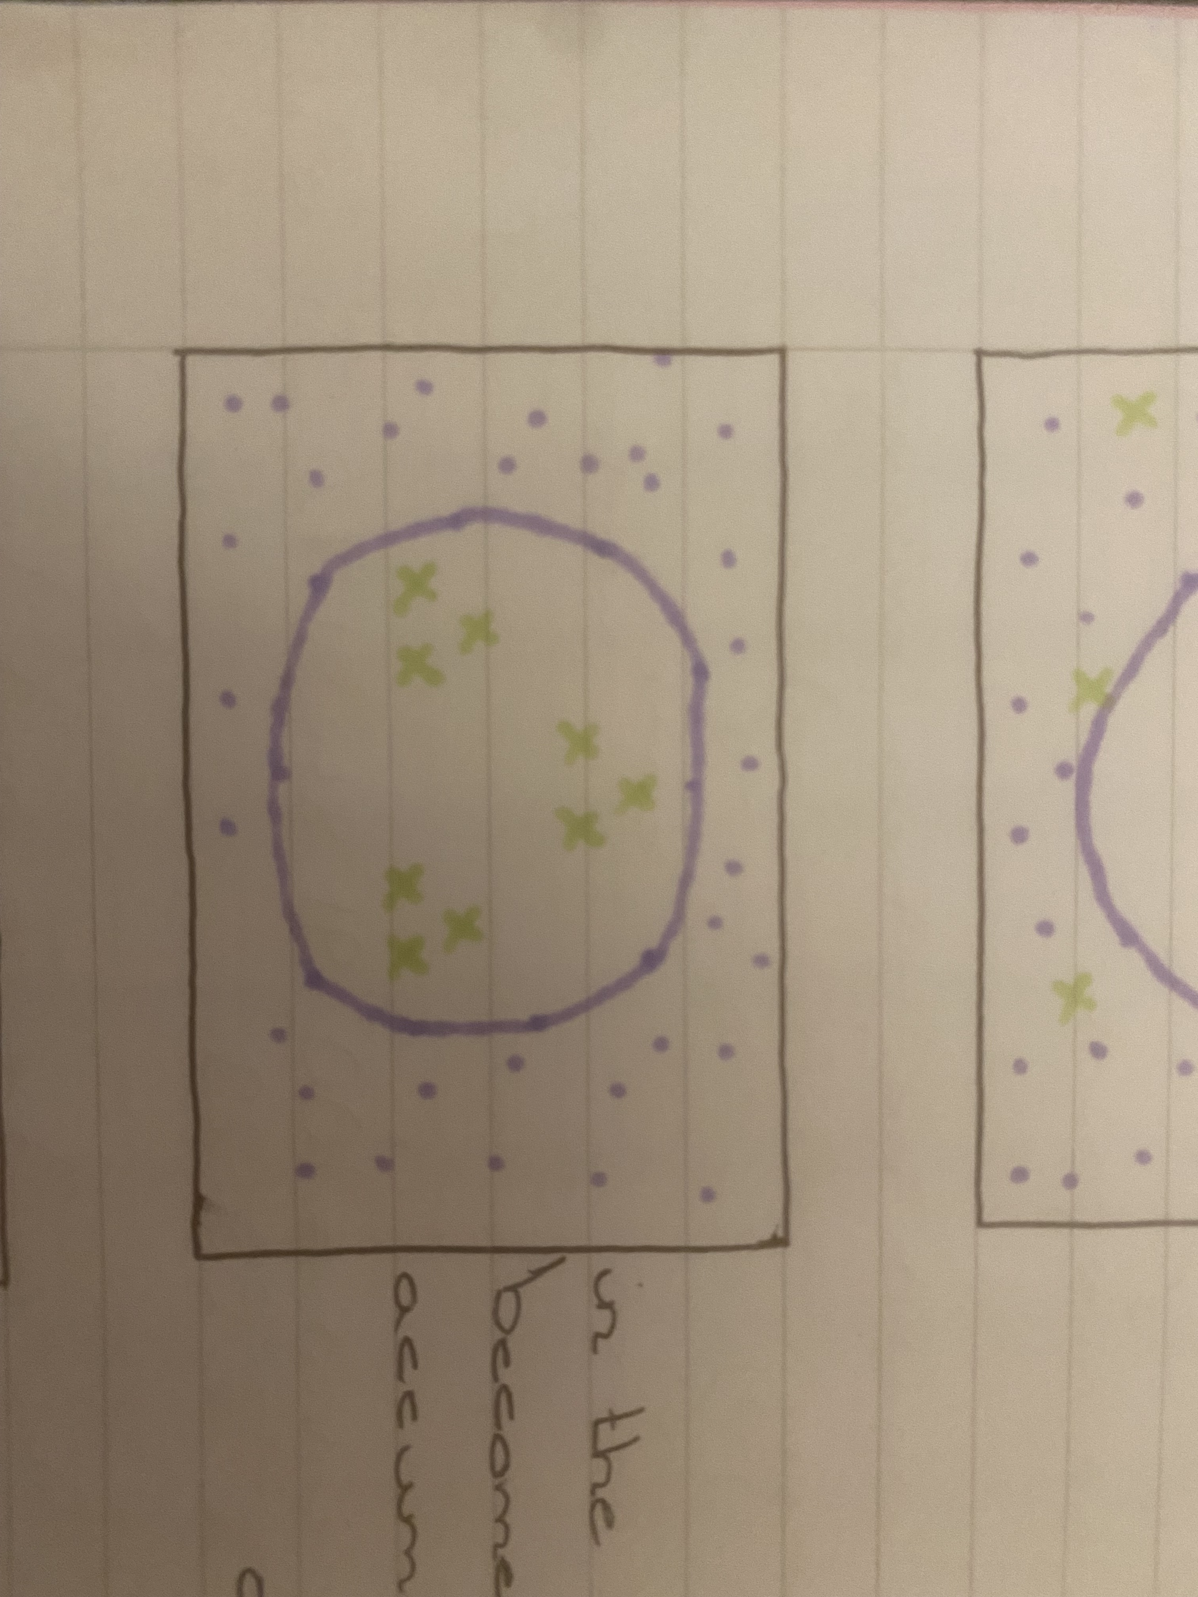
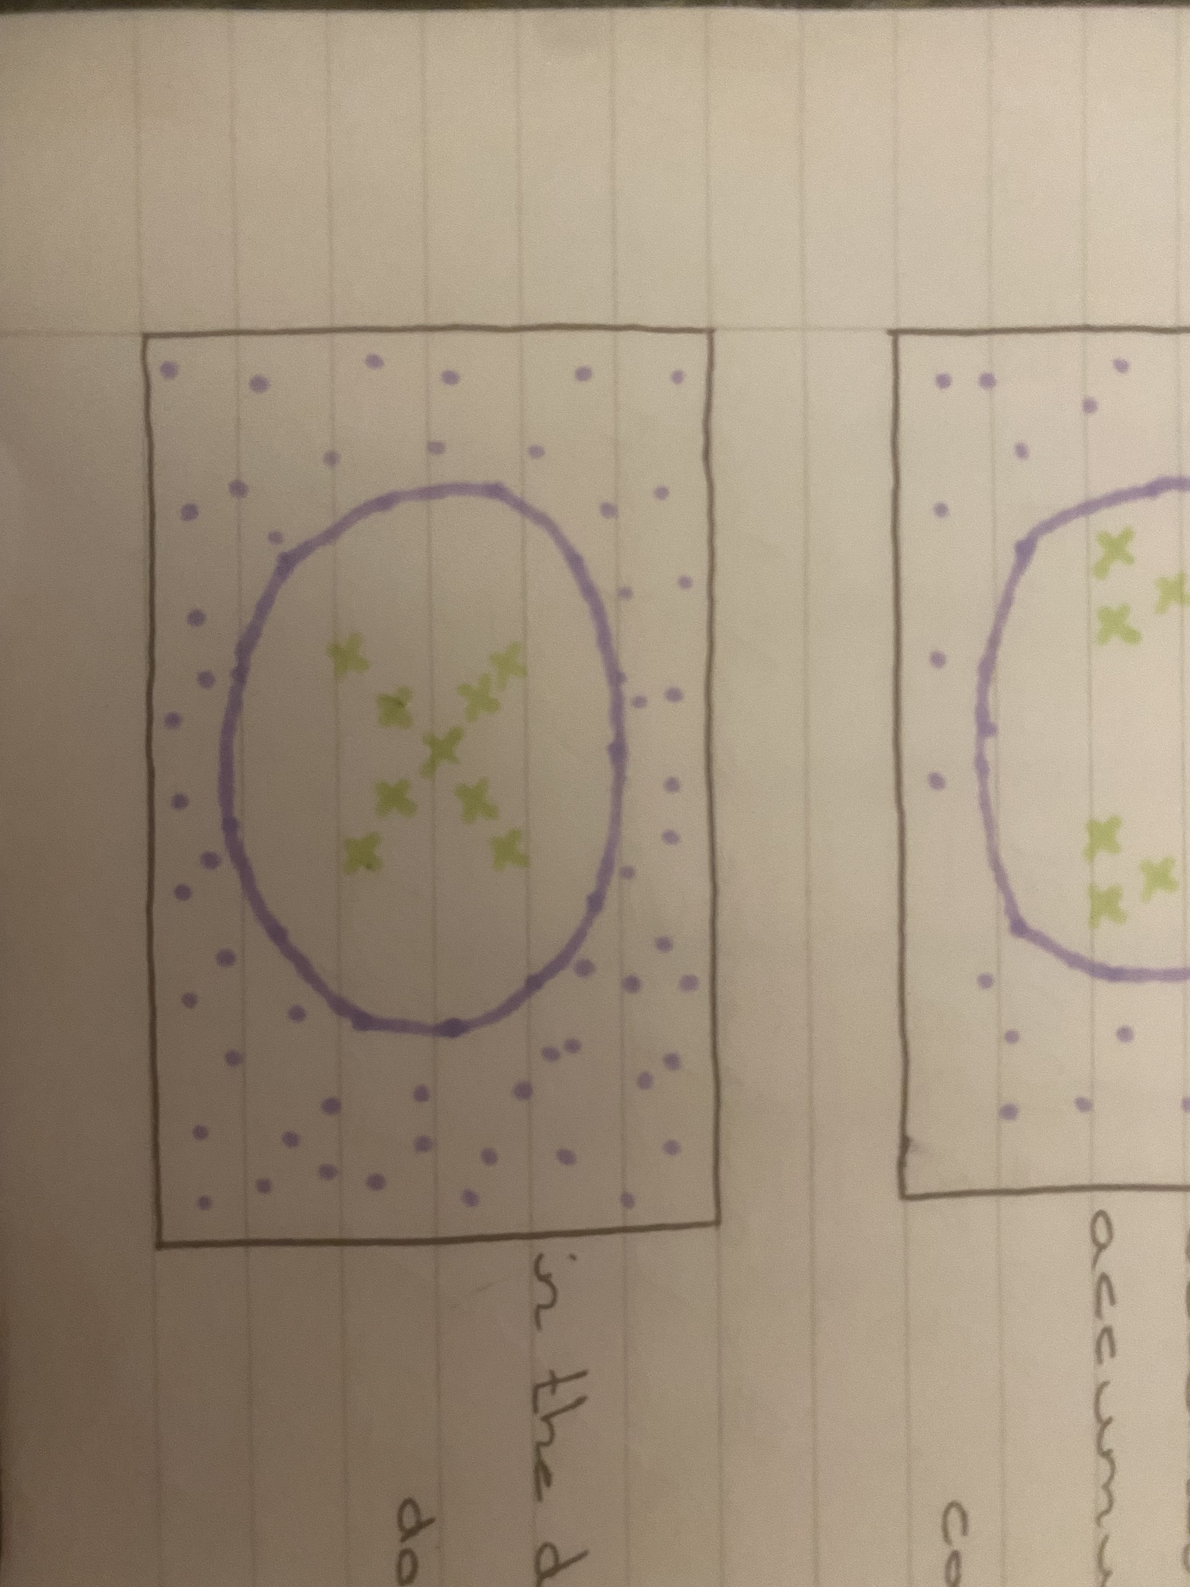
Music ideas and movement ideas
My main music ideas is a mix of ‘We are all going to die’ by Eomac and ‘Teardrop’ by Massive Attack.
I have chosen these two music choices because it not only fits the chaotic atmosphere but also has an undertone that could be used for contemporary or even more isolations and sharper movements.
I chose to mix the songs because it will not only add tension but also be more intriguing for the audience to watch and listen too.
I would like to use the main style of contemporary but also make sure to use isolations and sharper movements with hands mainly and also the rest of the body.
Another movement idea of mine is to use partners for contact work to show the idea of chaos and sanity.
There will be more unison towards the end of the dance to show the calming down at the end of an episode as well as showing that sanity has arrived for the ‘patient’.
I would want to make sure that while I am choreographing I am taking ideas from other people and using them within the routine.
These are formation ideas: The first picture is where the dancers are integrated into the audience. The second photo is during a section where everyone is placed in three’s. And the final picture is another section where the dancers are placed in a cross.

Slide 6
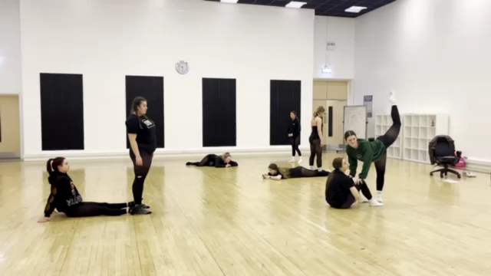
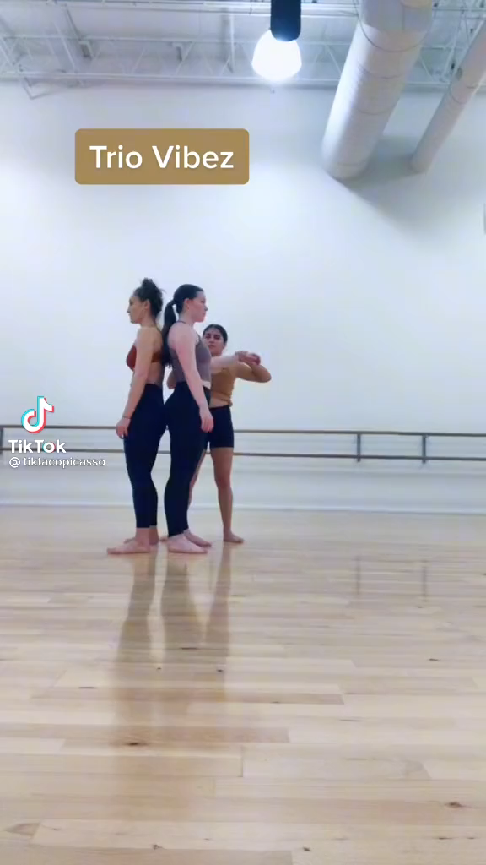
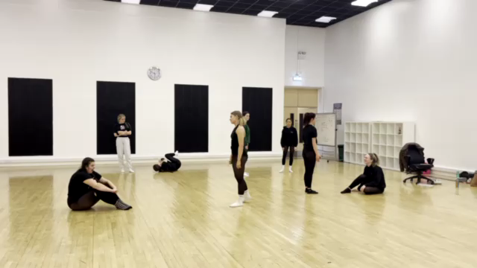
Movement Ideas AND INSPIRATION
This is Leila’s improvisation task and I got inspiration from this because I like the idea of Power and not having power, this could create a chaotic atmosphere that I want to portray.
This is my improvisation task and I got inspiration from this and their dancing because I liked the partner work and I could use this within the routine as part of the contact work section
- The first lift within this video I quite like as a lift that could be used on a climatic part of the routine with three dancers in each group, there would be three sets of this so all dancers are involved.
Maddie's FINAL ALDC SOLO "This Needs to Be My Best Performance Ever!" (S6 Flashback) | Dance Moms - YouTube
Mather Dance Company - Paint it Black - YouTube
At the end of this video there is a dance called hostage and I took inspiration from this because there are sharp movements that go with and also against the timing of the music. Also it is very contemporary and not just a lyrical style.
I got inspiration from this video because of not only the types of movements they do and the dynamics they use, but also the idea of different dancers doing different motifs all at separate times. Also, how they use the music to exaggerate some of their movements.

Slide 7
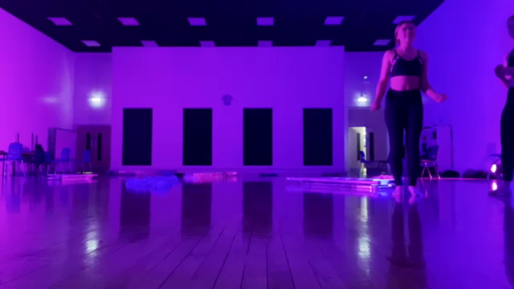
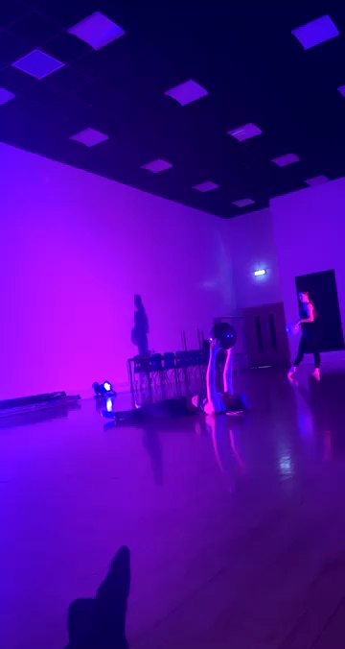
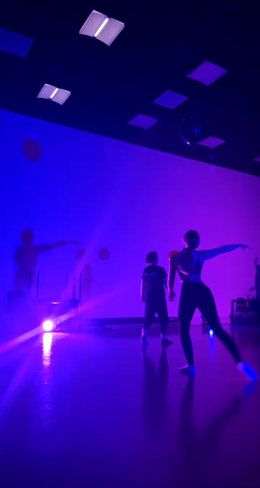
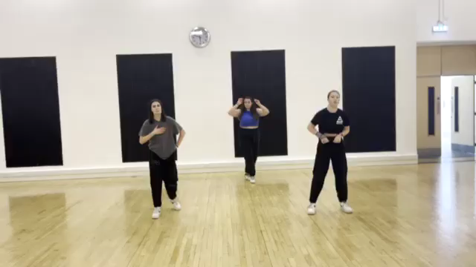
Extra Information
I also got inspired from when we did the Balloon Improvisation before Christmas because while I was watching I saw different and intriguing movements from some people that I could use in order to show the theme across to the audience.
Workshops that have helped inspire me is the Motionhouse workshop and also the Lara Hunt workshop. This is because within the Motionhouse one their was contact work and partner work that could be used within sections of the dance. Also the Lara Hunt used isolations and sharper dynamics which is also what I would like to achieve in this piece.

Slide 8
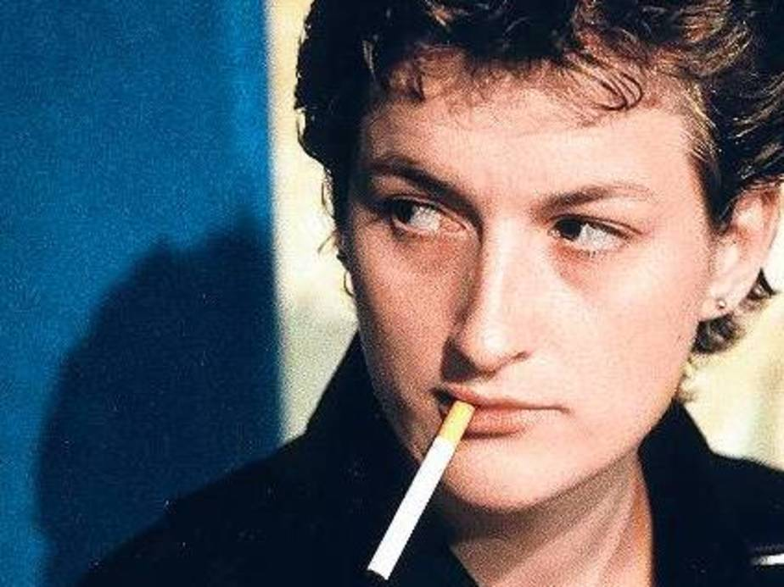
Thank you for watching my pitch

